Slide 1
Process Models
Dr. Adeel Ansari

Slide 2
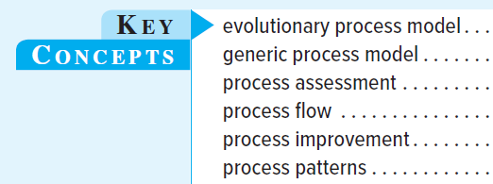
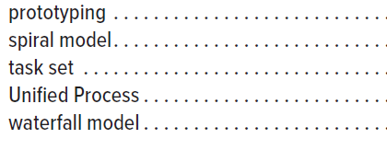
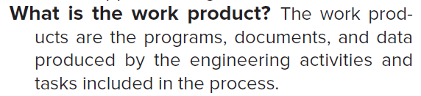
Key Concepts
we define a software process as a framework for the activities, actions, and tasks required to build high-quality software.

Slide 3
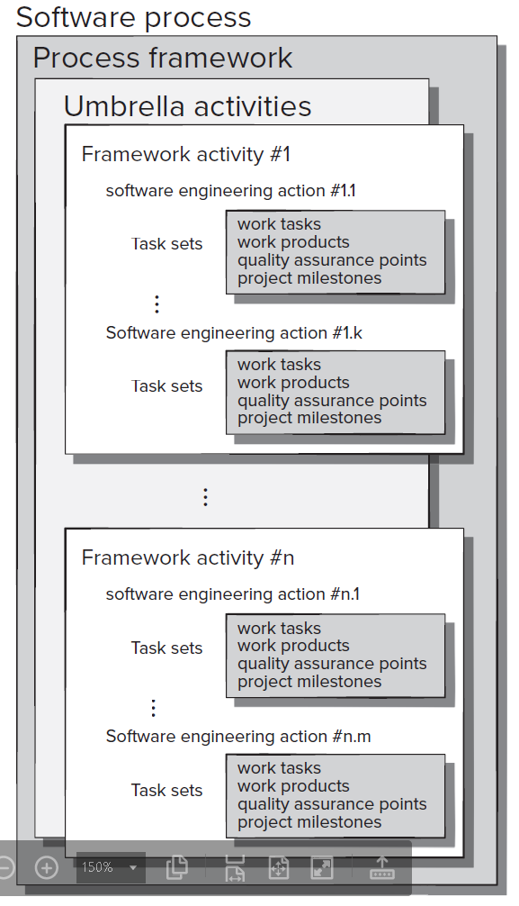
A Generic Process Model
Each framework activity is populated by a set of software engineering actions.
Each software engineering action is defined by a task set that identifies the work tasks that are to be completed, the work products that will be produced, the quality assurance points that will be required, and the milestones that will be used to indicate progress.
A set of umbrella activities—project tracking and control, risk management, quality assurance, configuration management, technical reviews, and others—are applied throughout the process.

Slide 4
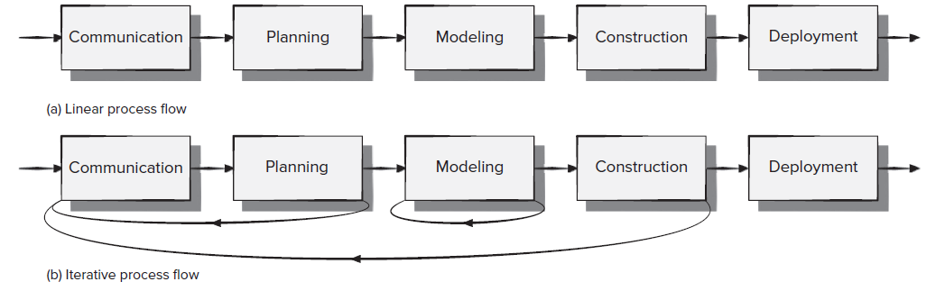
Process Flow
Process flow—describes how the framework activities and the actions and tasks that occur within each framework activity are organized with respect to sequence and time.
A linear process flow executes each of the five framework activities in sequence
An iterative process flow repeats one or more of the activities before proceeding to the next

Slide 5
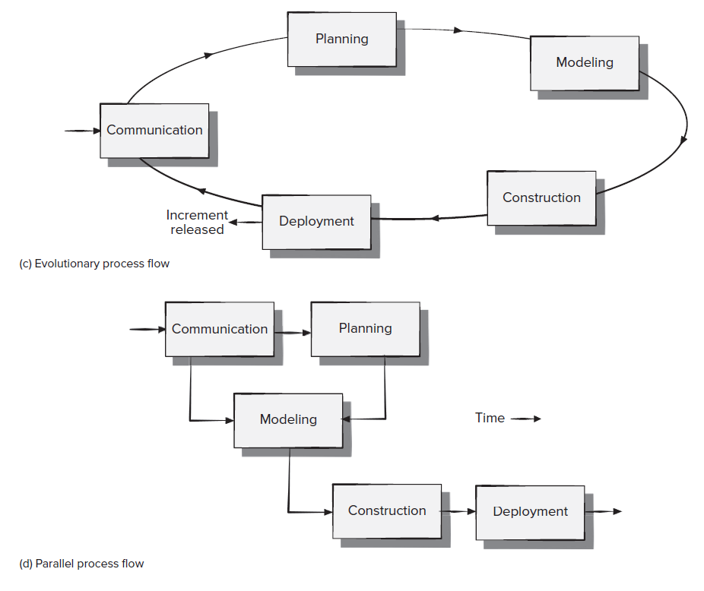
Process flow
An evolutionary process flow executes the activities in a “circular” manner.
A parallel process flow executes
one or more activities in parallel with other activities

Slide 6
Defining a framework activity
Key Question
What actions are appropriate for a framework activity, given the nature of the problem to be solved, the characteristics of the people doing the work, and the stakeholders who are sponsoring the project?
For a small software project requested by one person with simple, straightforward requirements, the communication activity might encompass little more than a phone call or e-mail with the appropriate stakeholder.
If the project was considerably more complex with lots of stakeholders, each with a different set of (sometimes conflicting) requirements, the communication activity might have six distinct actions: inception, elicitation, elaboration, negotiation, specification, and validation.

Slide 7
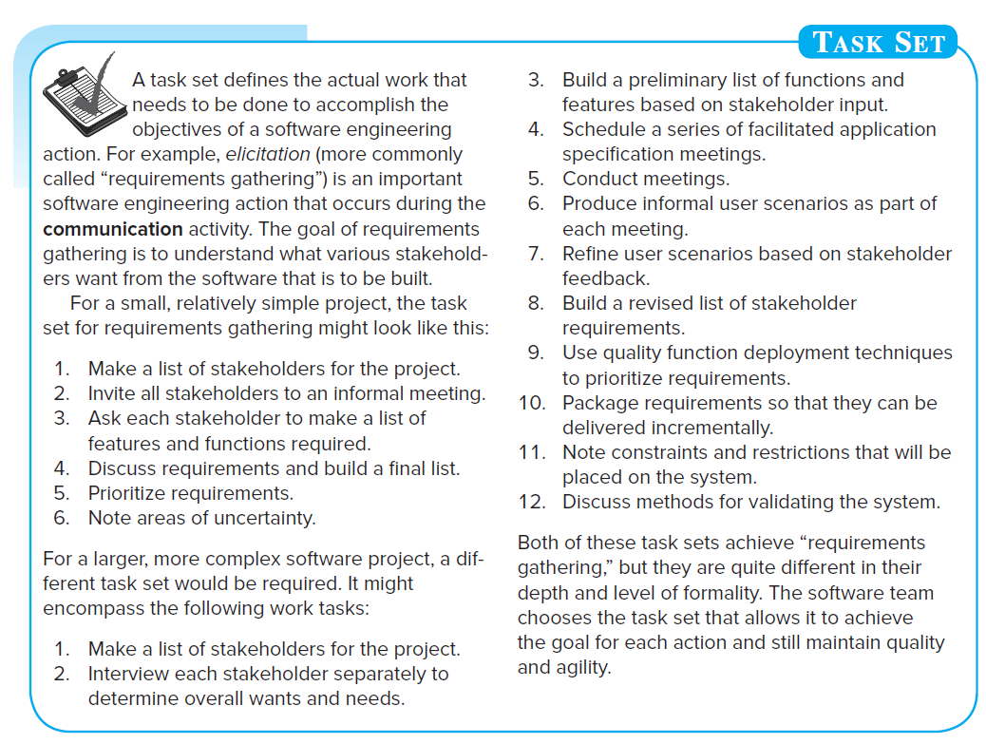
Identifying a task set
Different projects demand different task sets.

Slide 8
Process Assessment & improvement
Process patterns must be coupled with solid software engineering practice
The Capability Maturity Model Integration (CMMI) helps organizations streamline process improvement, encouraging a productive, efficient culture that decreases risks in software, product, and service development.
Using the Team Software Process (TSP), along with the Personal Software Process (PSP), an organization can build self-directed teams that plan and track their work, establish goals, and own their processes and plans.
The current thinking among most engineers is that software processes and activities should be assessed using numeric measures or software analytics (metrics).
Six Sigma for software may be applied to achieve improved customer service after delivery of the software, or improved customer satisfaction and value realization from the software product feature set delivered.
Six Sigma for Software applies to the software process, the software product, and to balancing the voice of the customer and the voice of the business to maximize overall business value resulting from processes and products.

Slide 9
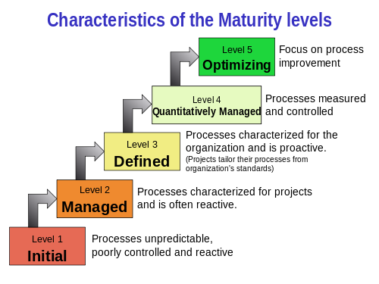
CMMI
CMMI addresses three areas of interest:
Product and service development – CMMI for Development (CMMI-DEV),
Service establishment, management, – CMMI for Services (CMMI-SVC), and
Product and service acquisition – CMMI for Acquisition (CMMI-ACQ).
CMMI defines the following maturity levels for processes.
It is a process level improvement training and appraisal program.

Slide 10
TSP
PSP
The quality of a software system is determined by the quality of its worst components.
As a software professional, you are responsible for your personal process. You should measure, track, and analyze your work.
A stable, mature PSP allows you to
estimate and plan your work
meet your commitments
resist unreasonable commitment pressures
The initial TSP objective is to convince management to let your team be self directed.
A self-directed team
sets its own goals
establishes its own roles
decides on its own development strategy
defines its own processes
develops its own plans
measures, manages, and controls its own work
Self-directed teams do the best work.

Slide 11
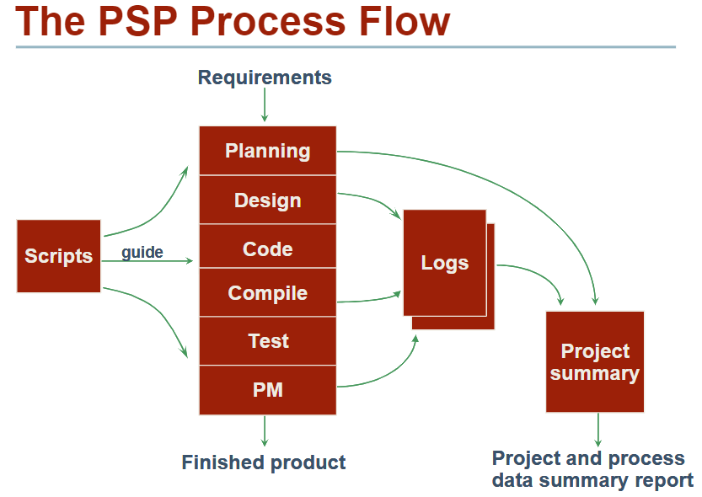

Slide 12
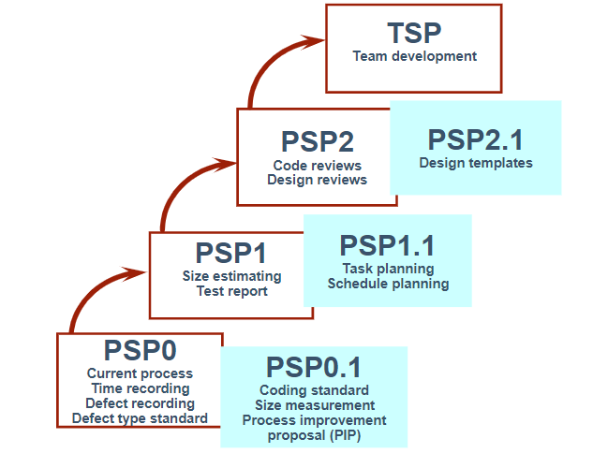

Slide 13
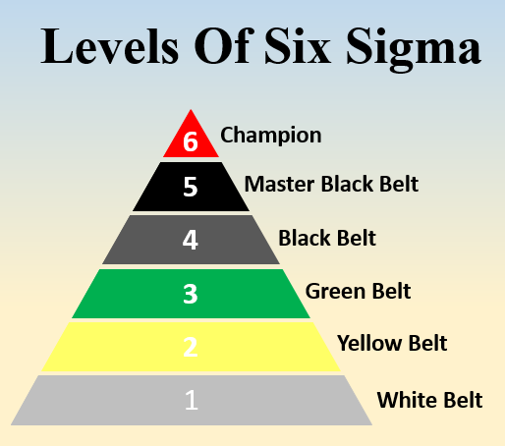
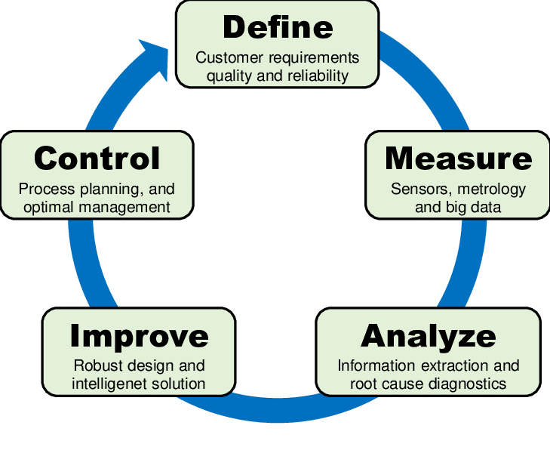
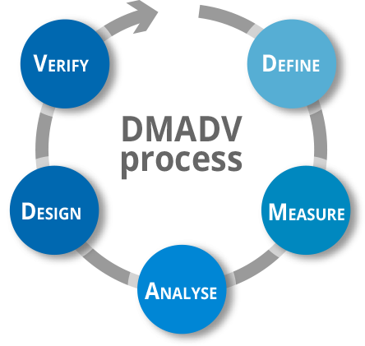
Six Sigma
Six sigma is a philosophy of doing business with a focus on eliminating defects through fundamental process knowledge. Six sigma methods integrate principles of business, statistics and engineering to achieve tangible results.
6 Sigma = 3.4 defects/million = % accurate
DMADV is used to create new product designs or process designs in such a way that it results in a more predictable, mature and defect free performance.
DMAIC is used to improve an existing business process.

Slide 14
Kano’s Analysis
The Kano Analysis model (pronounced “Kah-no”), also known as the “Customer Delight vs. Implementation Investment” approach, is an analysis tool that enables you to understand how customer emotional responses to products or features can be measured and explored.
Using a Kano model questionnaire (used to conduct customer-focussed research), product features are categorized across two-axis scales: satisfaction and functionality. With this, businesses can prioritize features on a product roadmap based on how likely they are to satisfy customers and the implementation investment.

Slide 15
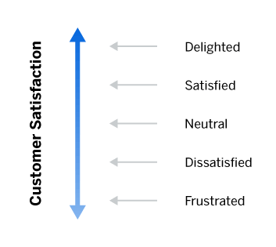
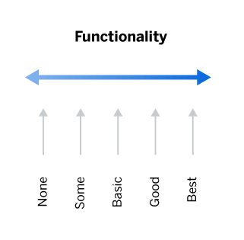
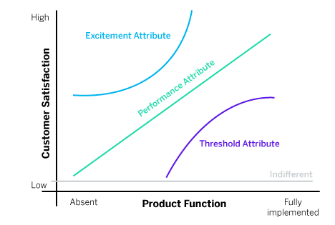
Kano’s Analysis
Kano’s Five Emotional Response Types
Must-be (or must have) features
Performance features
Attractive features
Indifferent features
Reverse features

Slide 16
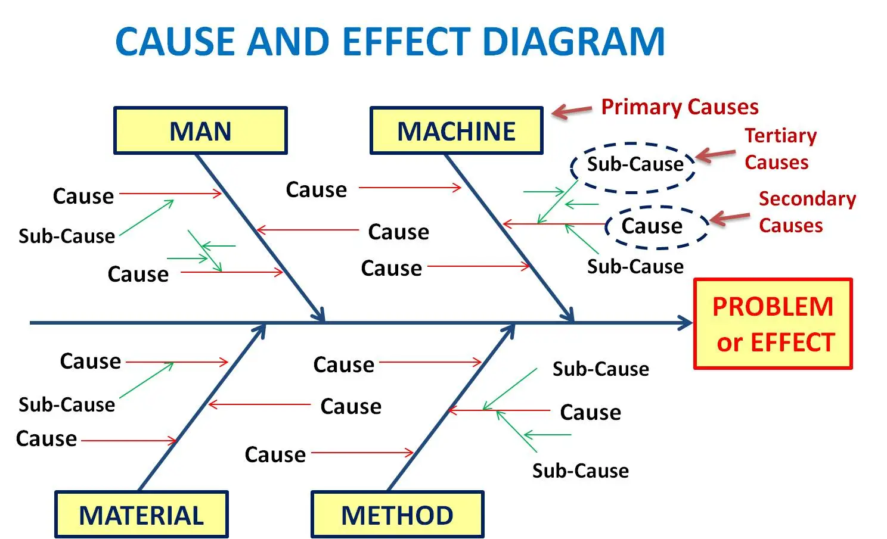
Cause and effect diagram
Fishbone Diagram | Ishikawa Diagram
It helps to Identify all potential or probable causes and select the best cause which contributes to the problem/effect.
The brainstorming technique is used here for potential cause identification.

Slide 17
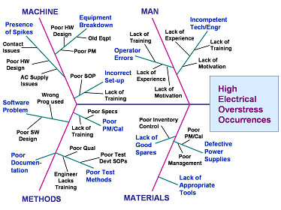
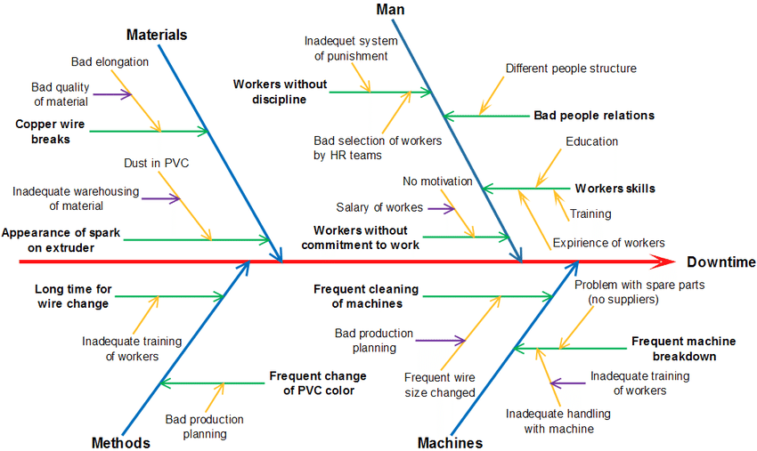
Cause and effect diagram
Fishbone Diagram | Ishikawa Diagram

Slide 18
Affinity diagram
The affinity diagram organizes a large number of ideas into their natural relationships.
It is the organized output from a brainstorming session.
Use it to generate, organize, and consolidate information related to a product, process, complex issue, or problem.

Slide 19
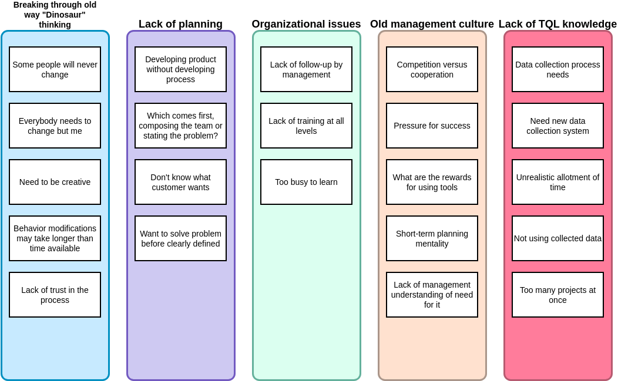

Slide 20
Why Projects fail
Large and small software projects fail for four reasons.
Project commitments are often unrealistic.
Larger projects are harder to control.
Quality problems get worse with project size.
Teams need leadership and coaching.

Slide 21
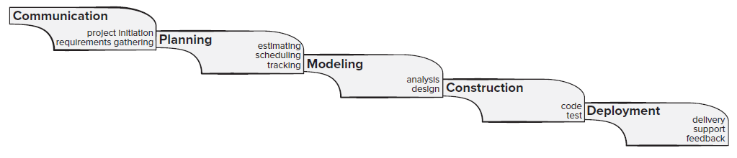
Prescriptive Process models
The Waterfall Model
The waterfall model, sometimes called the linear sequential model, suggests a systematic, sequential approach to software development that begins with customer requirements specifications till lastly software delivery.
Issues:
Real projects rarely follow the sequential work flow that the model proposes.
It is often difficult for the customer to state all requirements explicitly at the beginning of most projects.
The customer must have patience because a working version of the program(s) will not be available until late in the project time span.
Major blunders may not be detected until the working program is reviewed.

Slide 22
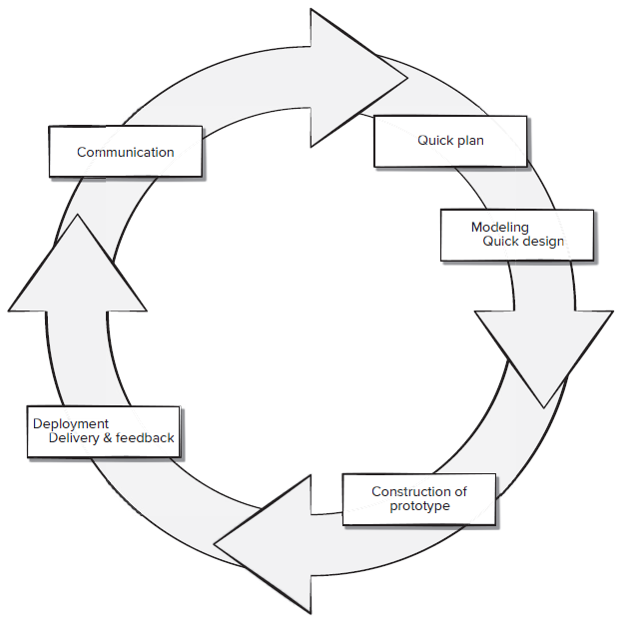
Prescriptive Process models
Prototyping Process Model
The prototyping paradigm assists you and other stakeholders to better understand what is to be built when requirements are fuzzy.
A prototyping iteration is planned quickly, and modeling (in the form of a “quick design”) occurs.
Ideally, the prototype serves as a mechanism for identifying software requirements.
If a working prototype is to be built, you can make use of existing program fragments
or apply tools that enable working programs to be generated quickly.

Slide 23
Prescriptive Process models
Evolutionary Process Model
In a situation where you need a process model that has been explicitly designed to accommodate a product that grows and changes.
the spiral model is an evolutionary software process model that couples the iterative nature of prototyping with the controlled and systematic aspects of the waterfall model. It provides the potential for rapid development of increasingly more complete versions of the software.
Using the spiral model, software is developed in a series of evolutionary releases.
During early iterations, the release might be a model or prototype. During later iterations, increasingly more complete versions of the engineered system are produced.

Slide 24
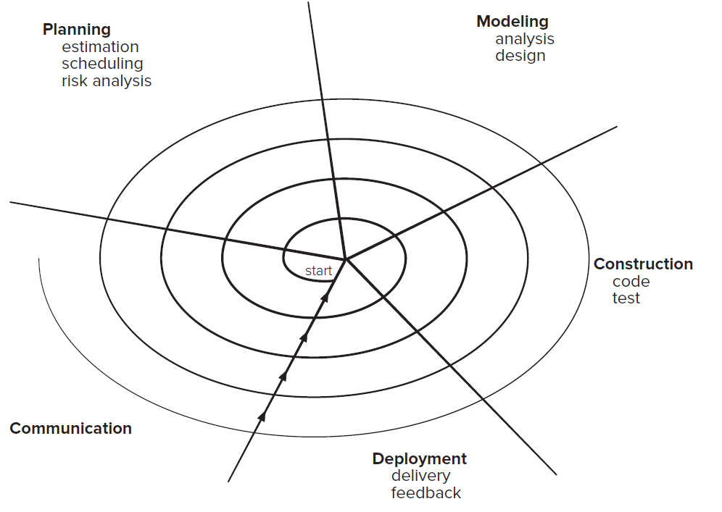
Prescriptive Process models
Evolutionary Process Model
The spiral model demands a direct consideration of technical risks at all stages of the project and, if properly applied, should reduce risks before they become problematic.
The intent of evolutionary models is to develop high-quality softwares in an iterative or incremental manner.

Slide 25
Prescriptive Process models
Unified Process Model
The Unified Process recognizes the importance of customer communication and streamlined methods for describing the customer’s view of a system (the use case).
It emphasizes the important role of software architecture and “helps the architect focus on the right goals, such as understandability, reliance to future changes, and reuse”
UML, the unified modeling language, was developed to support their work. UML contains a robust notation for the modeling and development of object-oriented systems and has became a defacto industry standard for modeling software of all types.

Slide 26
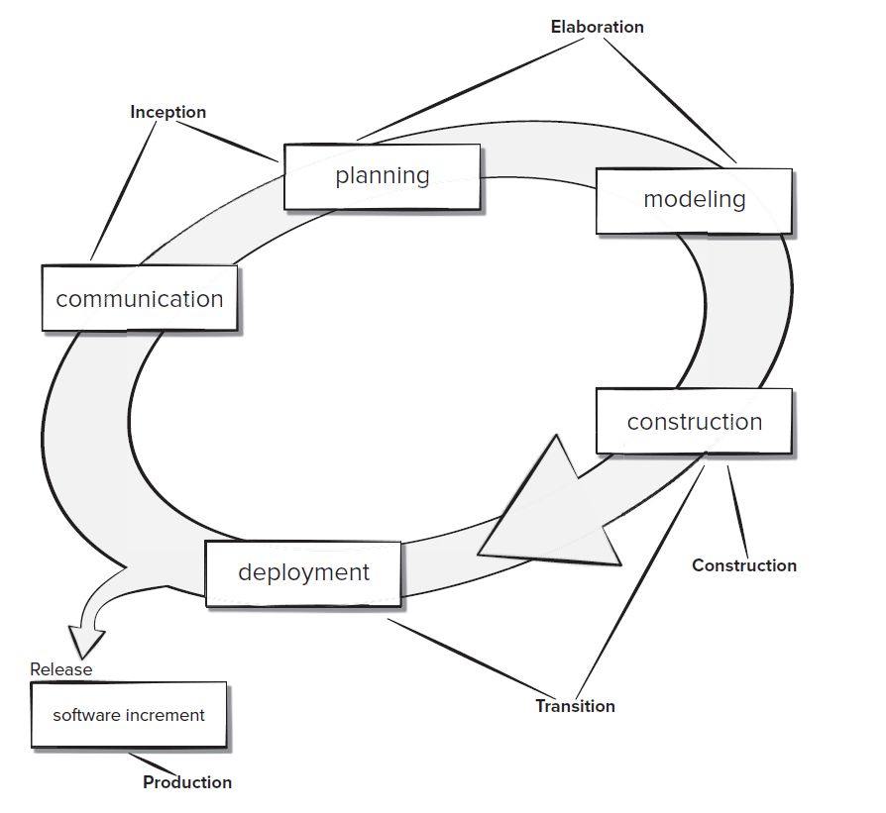
Prescriptive Process models
Unified Process Model
The inception phase of the UP is where customer communication and planning takes place.
The elaboration phase encompasses the planning and modeling activities of the generic process model
The construction phase of the UP is identical to the construction activity defined for the generic software process.
The transition phase of the UP encompasses the latter stages of the generic
The construction activity and the first part of the generic deployment (delivery and feedback) activity.
The production phase of the UP coincides with the deployment activity of the generic process.

Slide 27
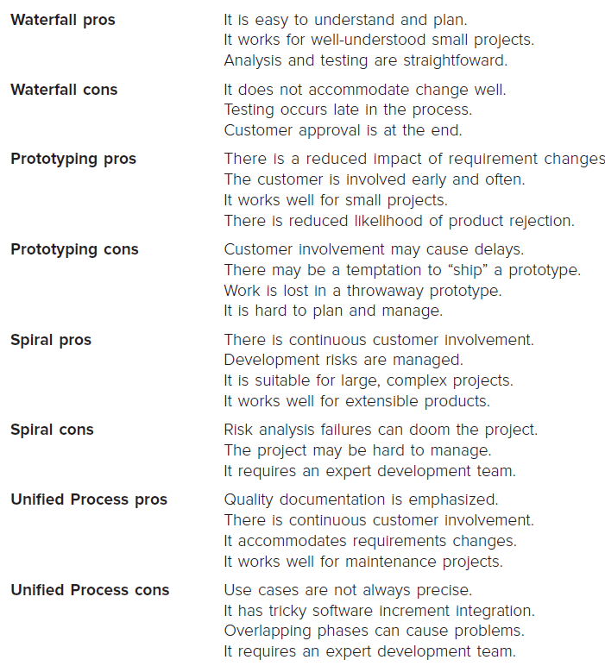
Product & Process
If the process is weak, the end product will undoubtedly suffer.
People derive as much (or more) satisfaction from the creative process as they do from the end product.
The reality is that no process is perfect for every project. Usually the software team adapts one or more of the process models

Slide 28
Questions
Are the Unified Process and UML the same thing? Explain your answer.
Provide three examples of software projects that would be amenable to the prototyping model. Be specific.
Discuss the differences among the various process flows described. Identify the types of problems that might be applicable to each of the generic flows described.

